Slide 1
Generate images based on the smallNorb dataset
Generative Adversarial Networks
Dirk Stulgies, Prosper Kwabena Adjoin

Slide 2

Introduction
This project was created as part of the opencampus.sh course Generative Adversarial Networks.
The goal was to train a neural network with the smallNorb dataset and afterwards generate images similar to those in the original dataset.

Slide 3
Dataset
Images of 50 toys.
Imaged by two cameras
Five categories (four-legged animals, human figures, airplanes, trucks, and cars)
Ten instances (lion, hippo, van etc.)
Six lighting conditions
Nine elevations (30 to 70 degrees every 5 degrees)
18 azimuths (0 to 340 every 20 degrees)
Ill. 1: Images from the smallNorb dataset

Slide 4
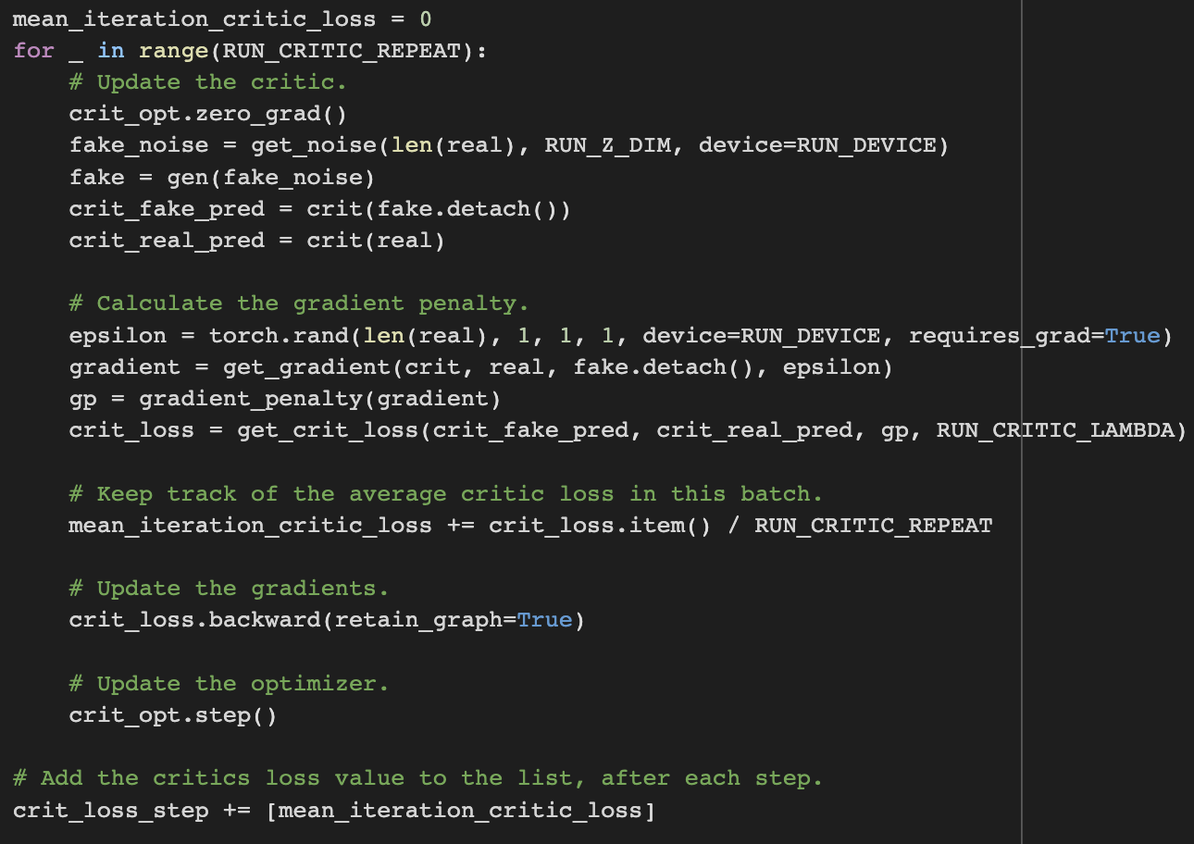
Network
Wasserstein GAN
Gradient penalty
Adam optimize
BCE with logins loss function
Initialise weights for Conv2D and Conv2DTranspose based on normal distribution.
Ill. 2: Coded snippet, critics repeat, adding gradient penalty.

Slide 5
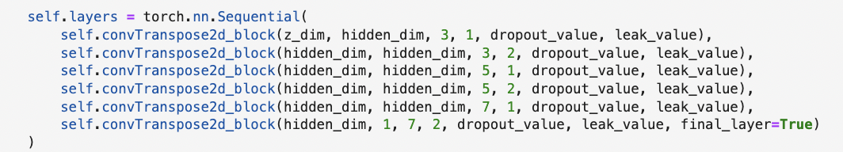
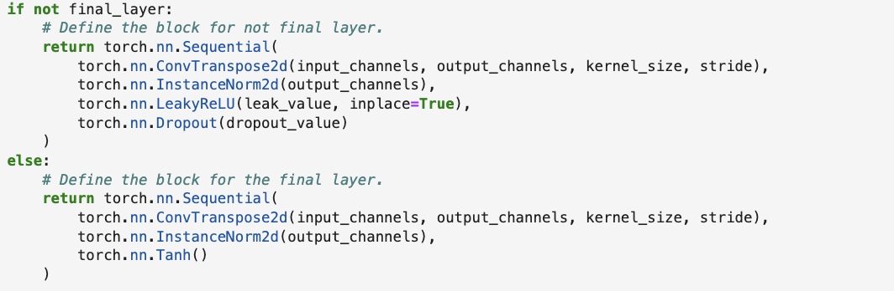
Generator
Five blocks containing:
ConvTranspose2d layer
InstanceNorm2d layer
LeakyReLU activation layer
Dropout layer
The final block containing:
ConvTranspose2d layer
InstanceNorm2d layer
Tanh activation layer
Ill. 3: Code snippet, generator structure.

Slide 6
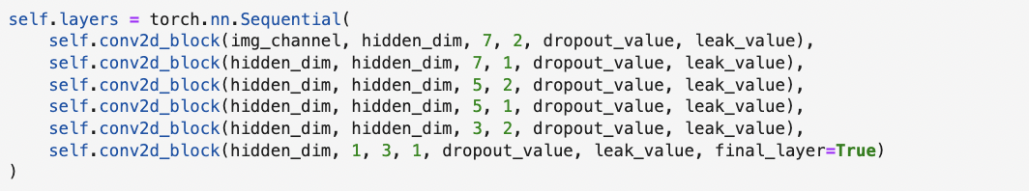
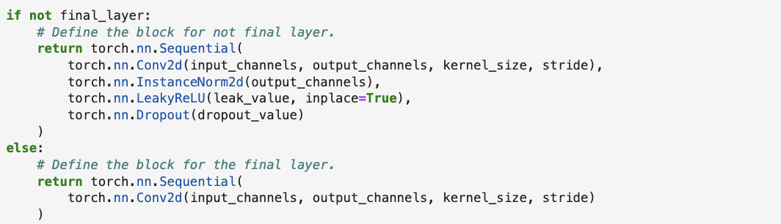
Critic
Five blocks containing:
ConvTranspose2d layer
InstanceNorm2d layer
LeakyReLU activation layer
Dropout layer
The final block containing:
ConvTranspose2d layer
InstanceNorm2d layer
Tanh activation layer
Ill. 4: Code snippet, critics structure.

Slide 7
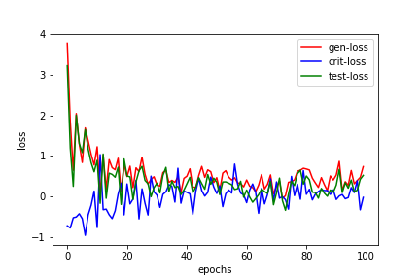
Results UNConditional gan
Ill. 6: Losses
Ill. 5: Results after each epoch.

Slide 11
References
Dataset
smallNorb dataset: https://cs.nyu.edu/~ylclab/data/norb-v1.0-small/
Cousera courses
Build basic GAN’s:
Buils better GAN’s
Apply GAN's
Code examples from other authors
Reading the smallNorb files: https://www.kaggle.com/code/leshabirukov/small-norb-load
Generating images based on the smallNorb dataset: https://medium.com/analytics-vidhya/applying-generative-adversarial-network-to-generate-novel-3d-images-ba70e1176dac

